Slide 1
Frame Relay
Presented by
Zahid Hasan
Roll: 18102027

Slide 2

Frame Relay ?
It is a packet-switching telecommunication service.
It is a set of communication standards for digital telephone connection.
It transmits voice, video and data over telephone line.

Slide 3
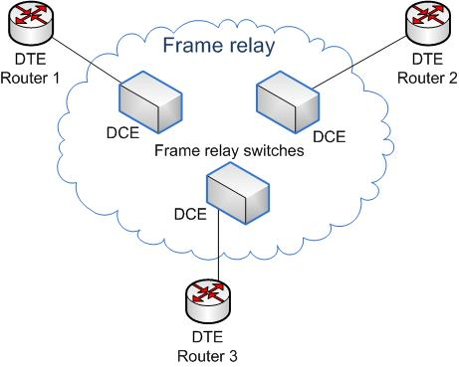
How does Frame Relay work ??
DTE-Data Terminate Equipment
DCE-Data Circuit-Terminating Equipment

Slide 4
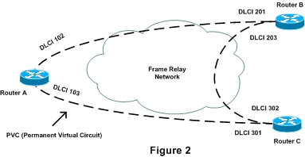
Frame Relay virtual circuit
Though there is no direct connection between the routers, they can communicate each other.

Slide 5
Advantages
Cost savings
Higher circuit utilization
Higher speed with lower delay as compared to X.25.
It compatible for newer technology like ATM.

Slide 6
Disadvantages
It creates varying delays for different users
It is not suitable for sending sensitive data such as real time voice, video or teleconferencing.
It allows variable length frames.
44 mbps data rate is not enough for higher data rates protocols.

Slide 7
Thank You

